Slide 1
Programming 4
07.1 Manual Scrolling Tile Map
Semester 2, 2019

Slide 2
Scrolling
The world can be much larger than what is shown on our screens
In a scrolling game, the tile mapping technique is the same
Except the map is bigger than the screen
Notes:
The screen displays a portion of the world, and during game play, in response to movement of a player character (in, e.g. RPGs) or in response to manual navigation by the player (in e.g. city builders), that portion changes
This movement is called scrolling

Slide 3
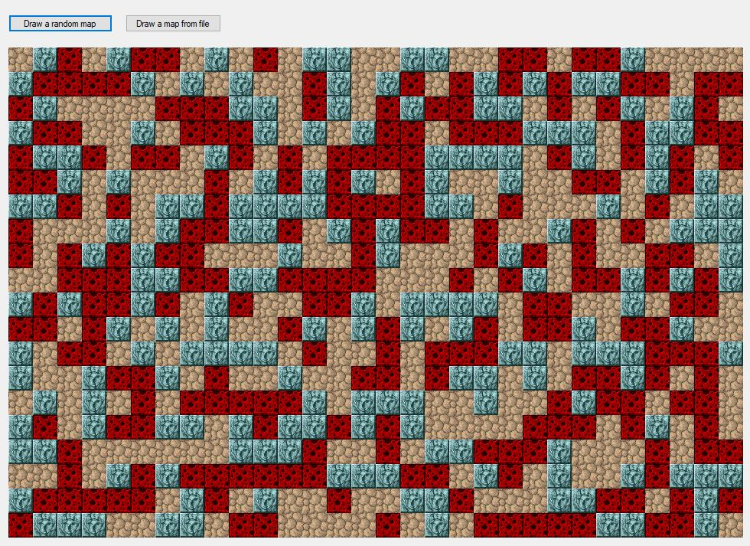
Scrolling

Slide 4
Example World
Super Mario Bros (NES)
SMB uses 16x16 pixel tiles
SMB uses a world that is very wide, but only one
screen high
Notes:
Using Super Mario Bros (Original NES version) as an example
SMB uses 16x16 pixel tiles, but everything here applies to any tile size
SMB uses a world that is very wide, but only one screen high. Again, everything here applies to games with large worlds in both dimensions. You just need to extend to the y‐axis
This image shows the whole world for one level. It is 211 tiles wide

